Slide 1
Predict ALS Progression and Survival
Shuyang Deng, Ben Guzman, Changxuan Wu

Slide 2
Introduction
ALS:
ALS involves the degeneration and death of the nerve cells in the brain and spinal cord that control voluntary muscle movement.
Progressive loss of motor function
Death typically occurs within 3 - 5 years of symptom onset.
No effective therapeutic options to cure it.
Goal:
Predict ALS progression ( the slope of the ALS Functional Rating Scale, ALSFRS) and probability of survival at 12 or more months by using data of 3 months records. Find strongest influence factors of ALS, predict clinical outcomes, and contribute to disease understanding and clinical care.

Slide 3
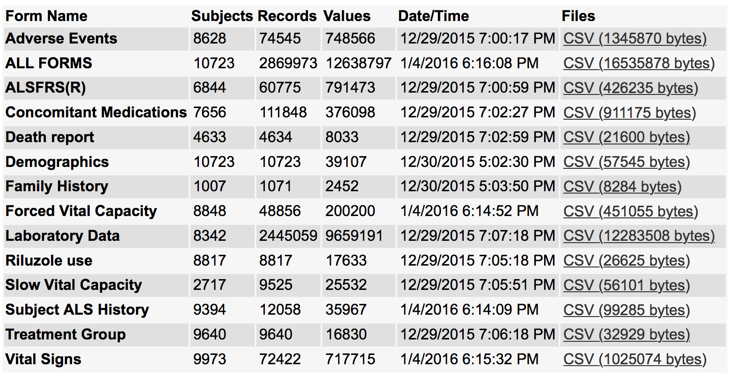
Exploratory Data Analysis
It is important to be familiar and friendlier with data sets you are handling so that we can get better patterns.
Data:
PRO-ACT database, which includes more than 10,000 patients from 23 completed ALS clinical trials.

Slide 4
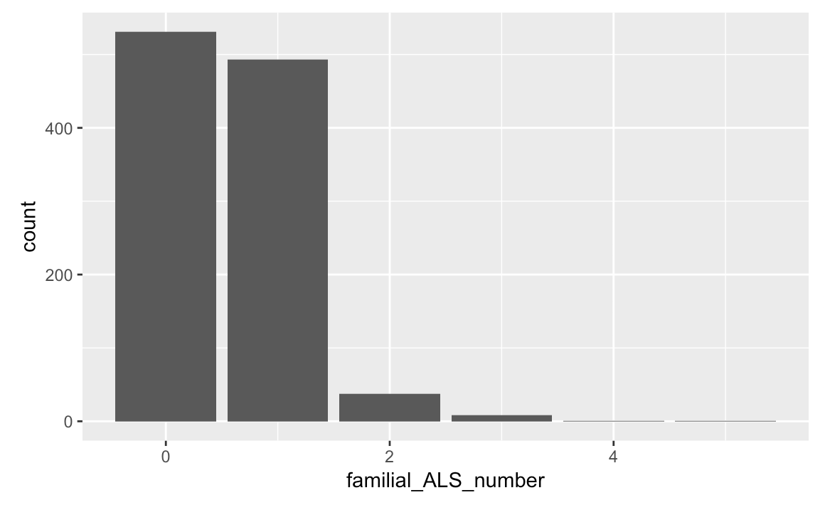
Family History
In some cases(5%), family members who have ALS can have influence on patients, which is caused by a genetic defect. This data information includes [Aunt, Cousin, Father, Grandfather, Grandmother, Mother, Nephew, Niece, Sibling, Son, Daughter, Sister, Brother.
In the data frame, “1” represents “have ALS”.
NA, which I change to “0”, means “do not have ALS”. Add the number of family members who have ALS to see the general relation between family history and patients.
One or zero patients’ family members also have ALS.
It is rare that 2 or more family members have ALS.
It is not hereditary.

Slide 5
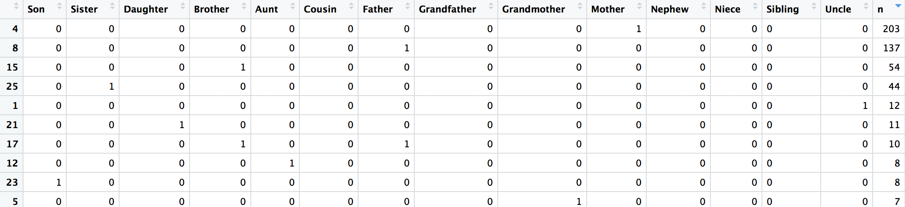
Family History
Mother, father, brother, and sister exert more influences on risk of ALS. They are more close to patients.
Disease-causing gene, Gene mutation
Only 5~10% ALS cases shows that family members also have the disease.

Slide 6
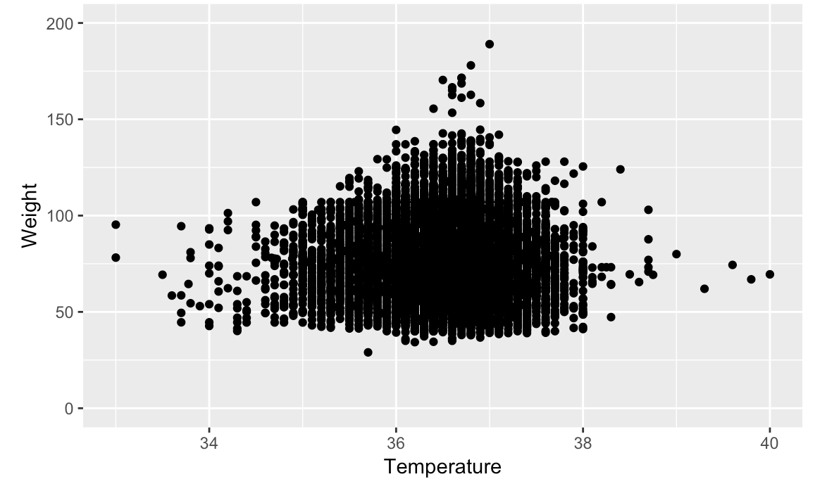
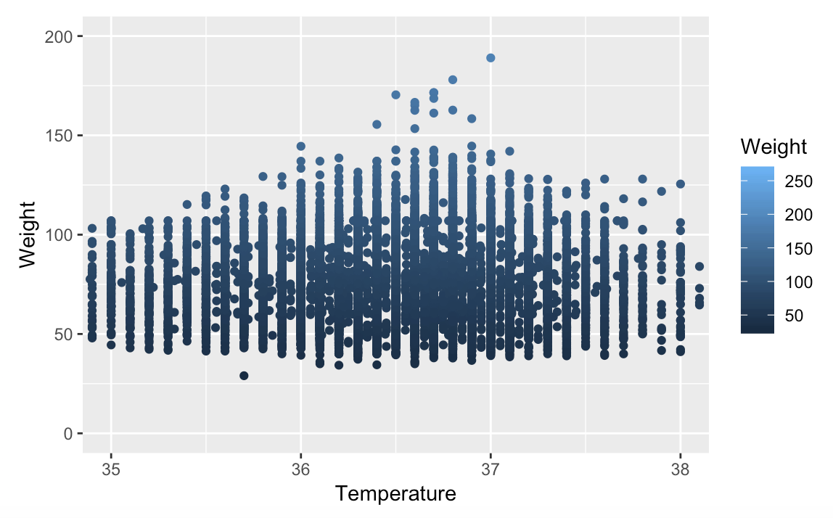
Vital Signs
Blood Pressure Diastolic, Blood Pressure Systolic, Temperature, Weight, Vital Signs Delta, etc.
Vital Signs Delta: the time when they were assessed compared to the first time they were assessed. Delta is from 0 to 560 days.
Patients’ temperatures are between 30 to 40 celsius degree, Weights are between 25 to 200 Kilograms.
Low fever, high fever, and normothermia. But each patient was tested many times during Delta. So we need to see the process of temperature changing.

Slide 7
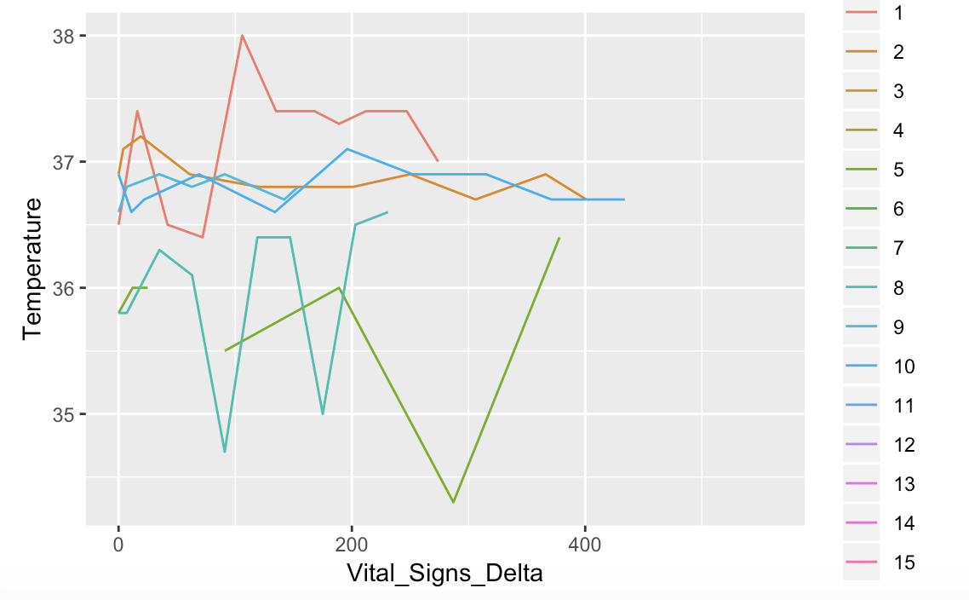
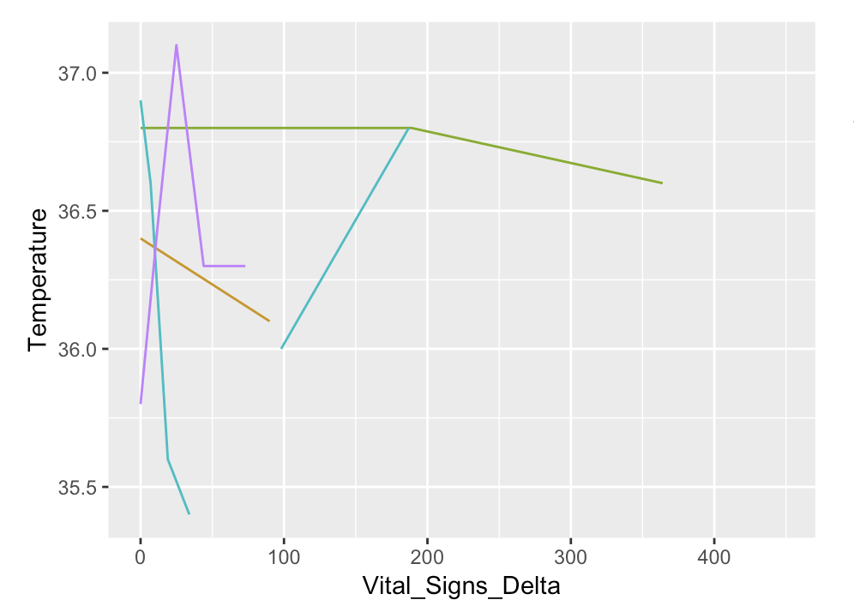
Vital Signs, Death
To see individual’s change of these signs during Vital Signs Delta.
Temperatures fluctuate strongly but are getting normal eventually during assessment delta.

Slide 8
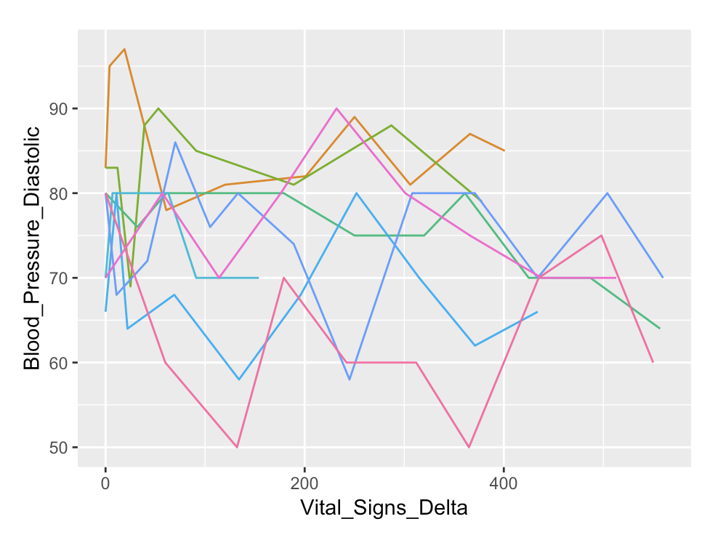
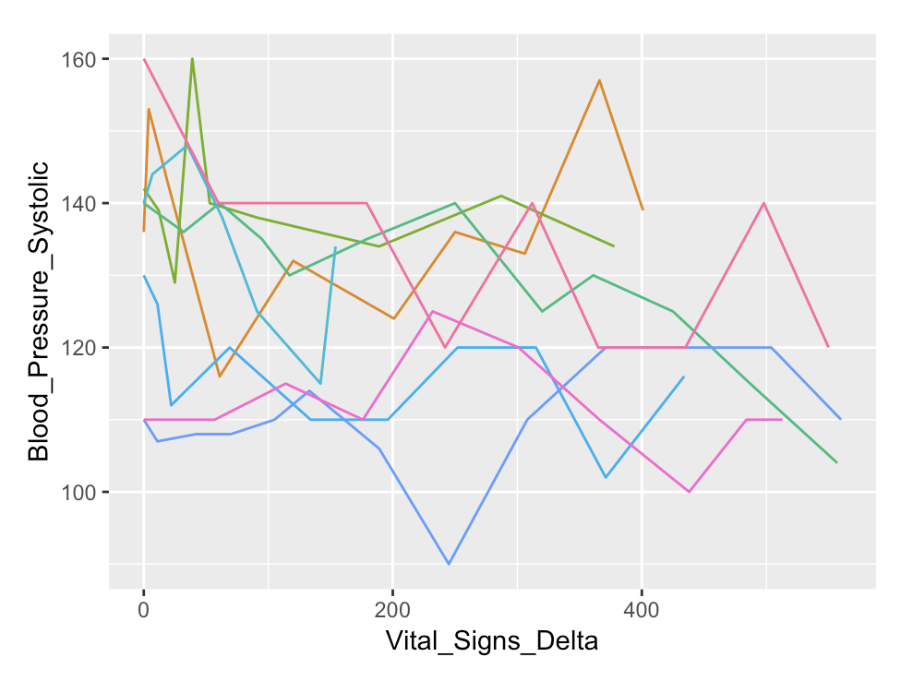
Vital Signs
Normal range of Blood Pressure: 139/89 mmHg
Blood Pressure Diastolic, Blood Pressure Systolic

Slide 9
Predictive Variables
Challenge: Predict Survival and Progression of ALS using only 6 Variables
So far, looked at baseline (Time=0, start of the trial):
ALSFRS-R Score
Scoring system that determines severity of symptoms.
Set of 12 Questions with (0=No Function, 4=Normal)
Highest=48 (Most Normal)
Ex: Speech, Salivation, Swallowing
Forced Vital Capacity (FVC)
Measures breathing functionality.
The lower, the more breathing functionality is affected
Laboratory
Creatinine Levels (Urine and Serum)
Neutrophils (Absolute Neutrophil Count)
Demographics

Slide 10
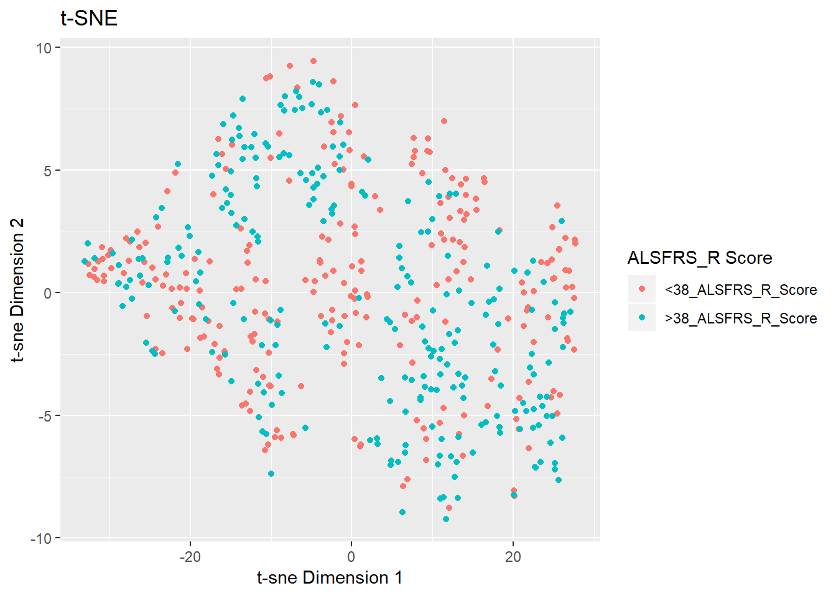
t-SNE
No Clear Separation

Slide 11
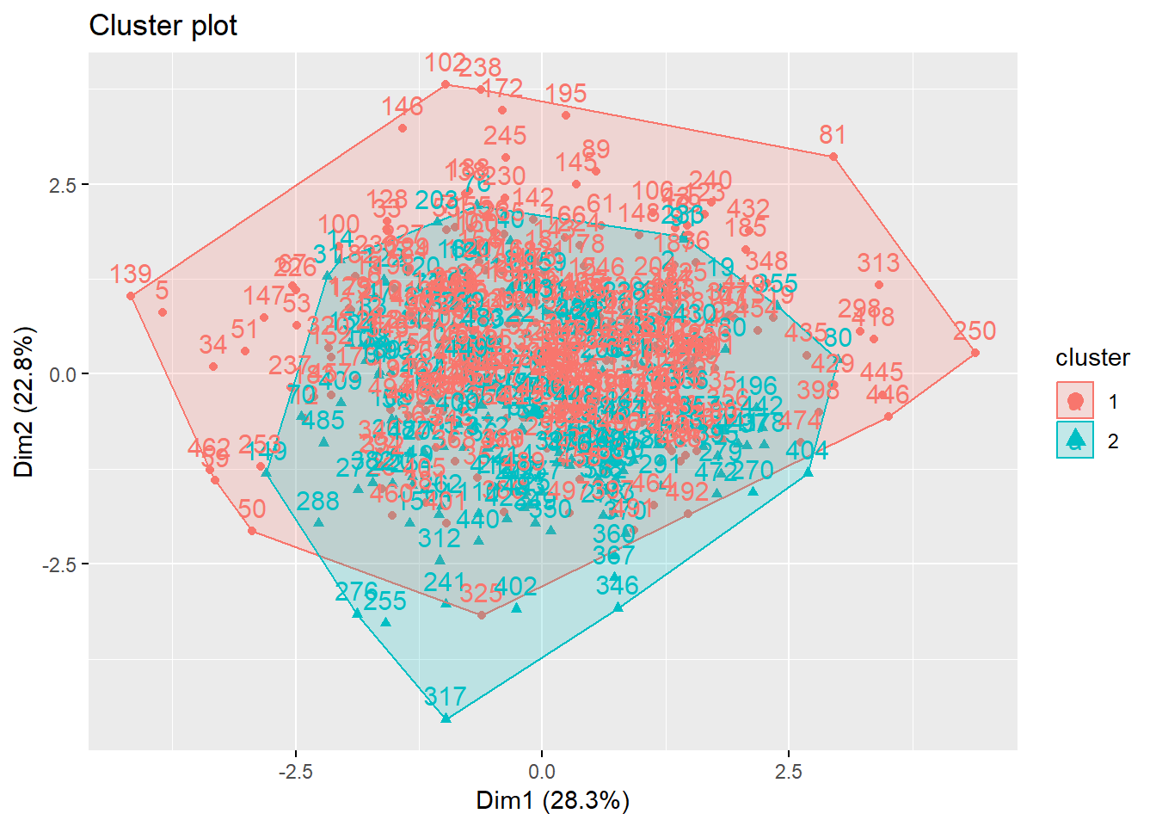
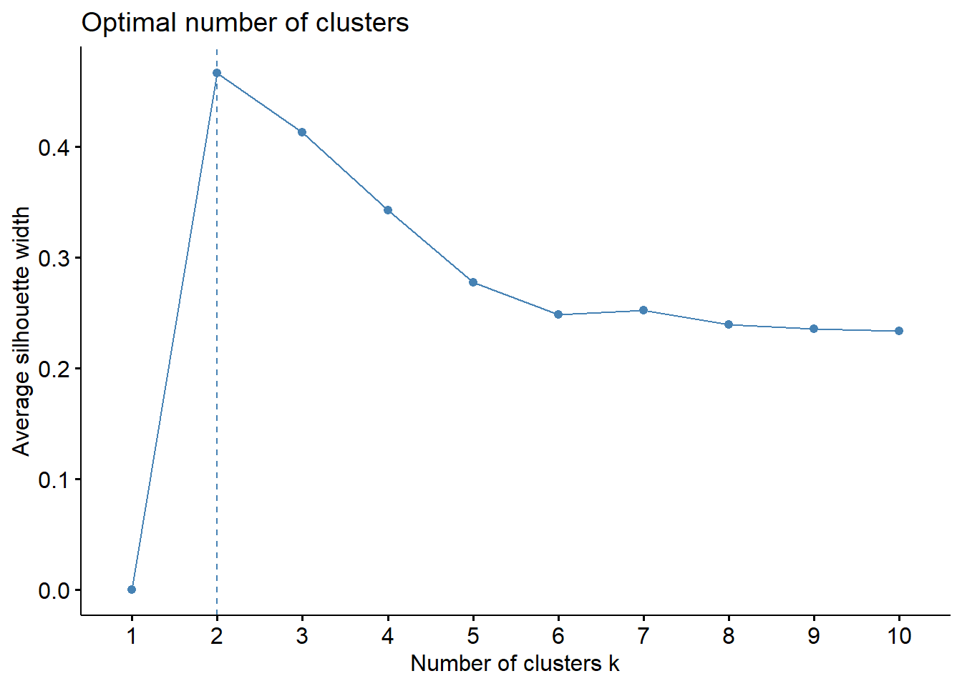
K-Means
No Clear Separation

Slide 12
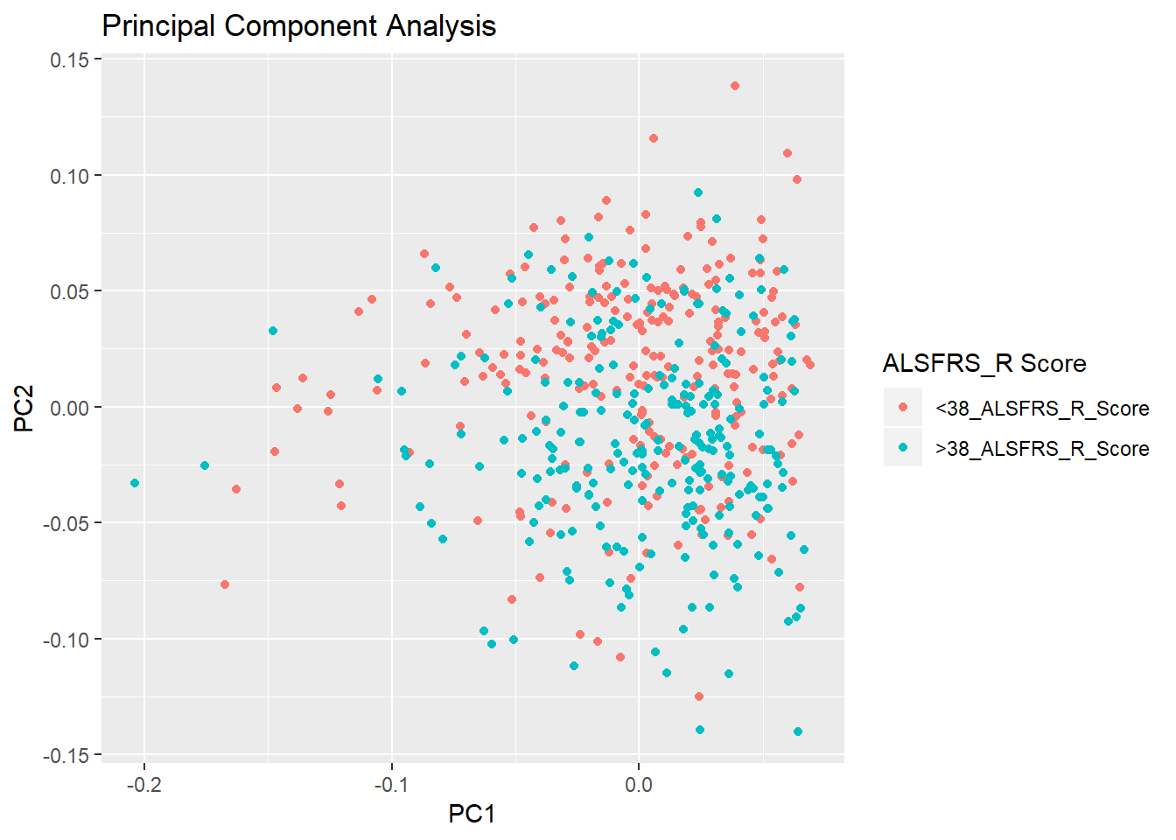
Principal Component Analysis
Category A: > 38 ALSFRS_R Score
Lower Creatinine Levels
Higher FVC
Higher Segmented Neutrophils
Category B: <38 ALSFRS_R Score
Higher Creatinine Levels
Lower FVC
Lower Segmented Neutrophils

Slide 13
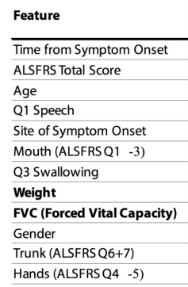
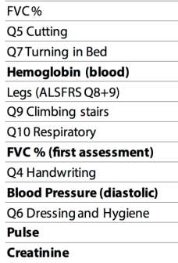

Slide 14
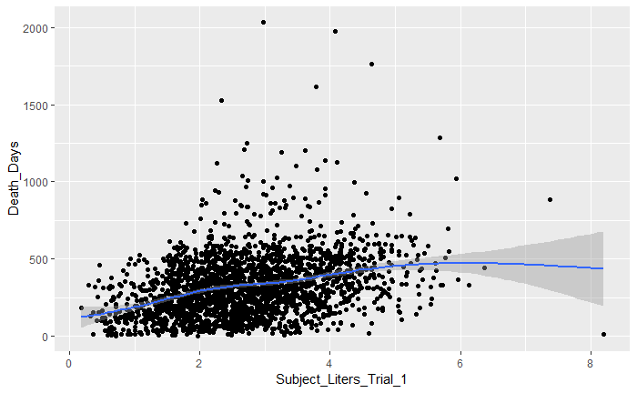
Survival time vs. Forced Vital Capacity

Slide 15
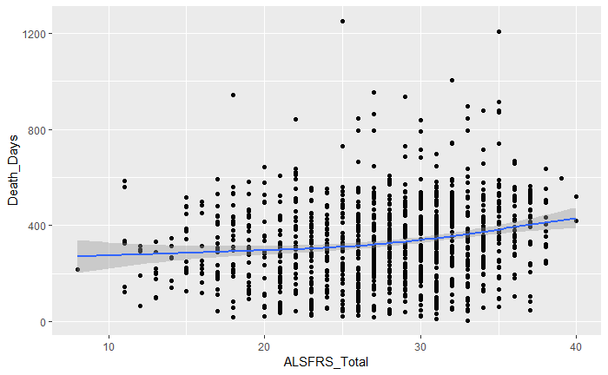
Survival time vs. ALSFRS score

Slide 16
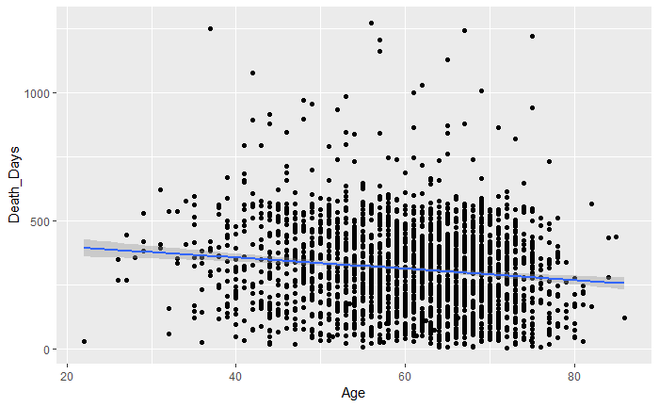
Survival time vs. Age

Slide 17
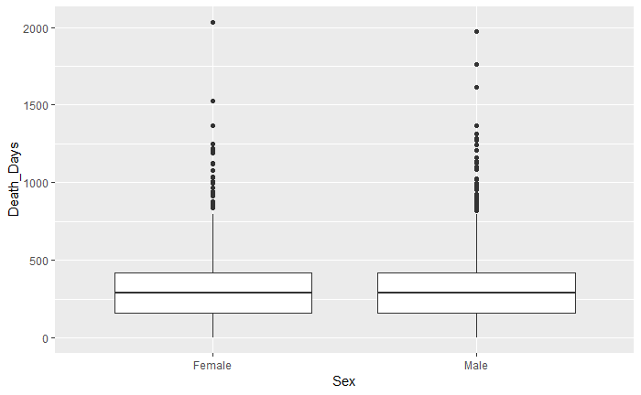
Survival time vs. Gender

Slide 18
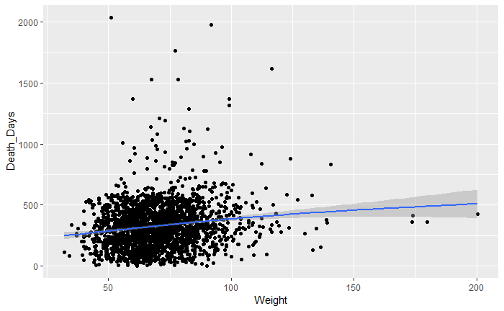
Survival time vs. Weight

Slide 19
references:
https://www.biorxiv.org/content/biorxiv/early/2018/04/05/294231.full.pdf
https://www.synapse.org/#!Synapse:syn2873386/wiki/391433
https://nctu.partners.org/ProACT/Document/DisplayLatest/2#anchor_4
https://kannan-kasthuri.github.io/Lecture_Files/PDA_Lecture_07/Lecture_07_Presentation.html#/1
https://kannan-kasthuri.github.io/pda_summer_18
http://r4ds.had.co.nz/exploratory-data-analysis.html

Slide 20
Thank you!

Slide 21
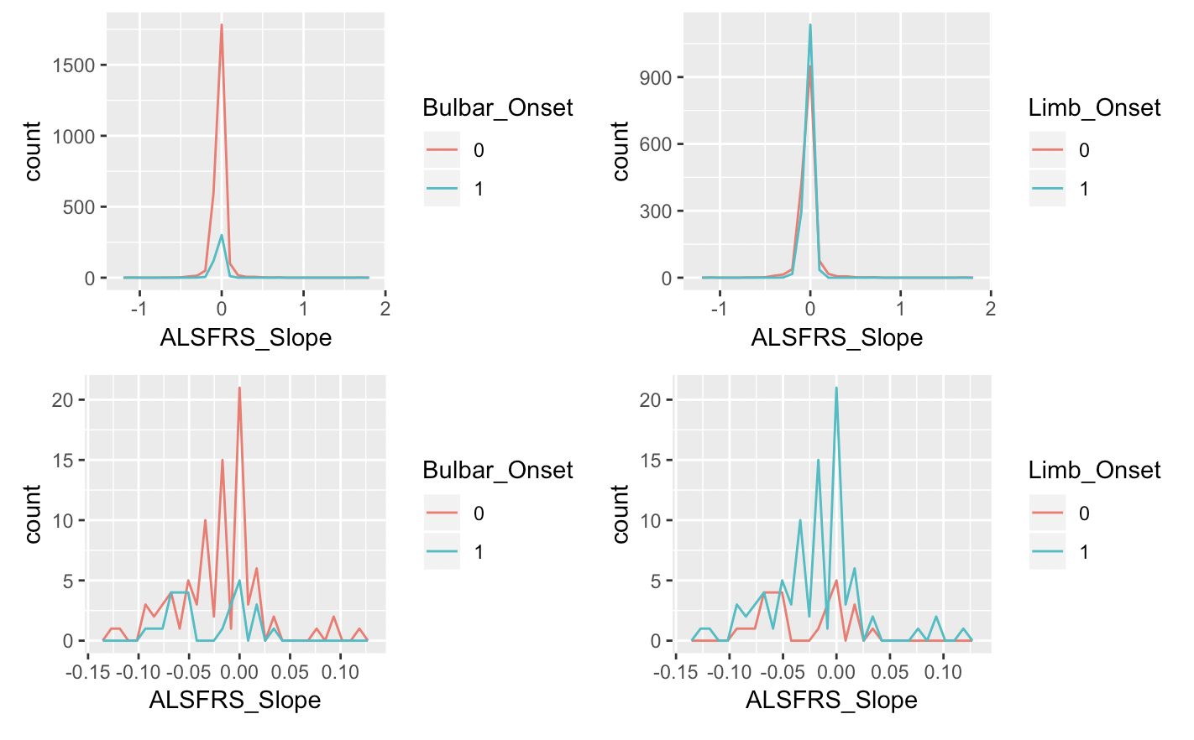
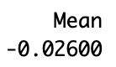
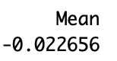
ALSFRS Slope
Cluster 1
Cluster 2

Slide 22
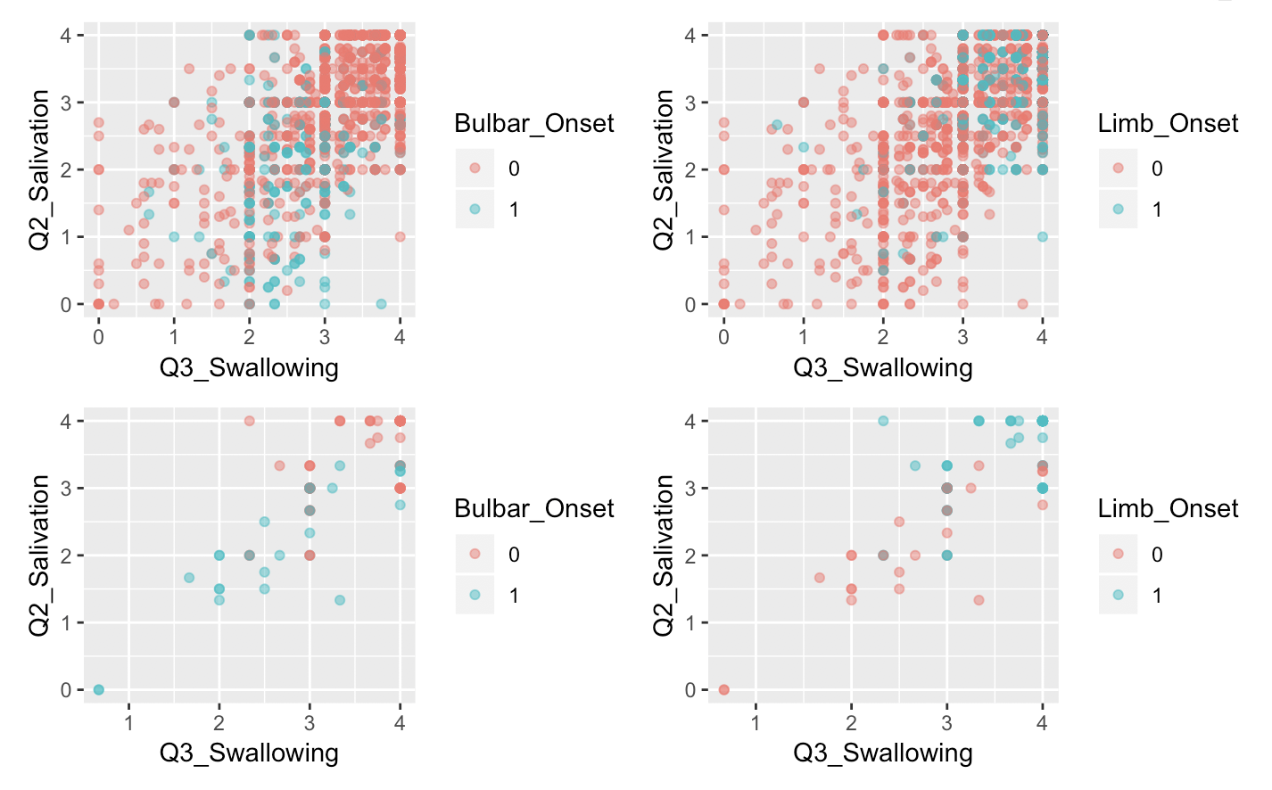
Q2 vs Q3
Cluster 1
Cluster 2

Slide 23
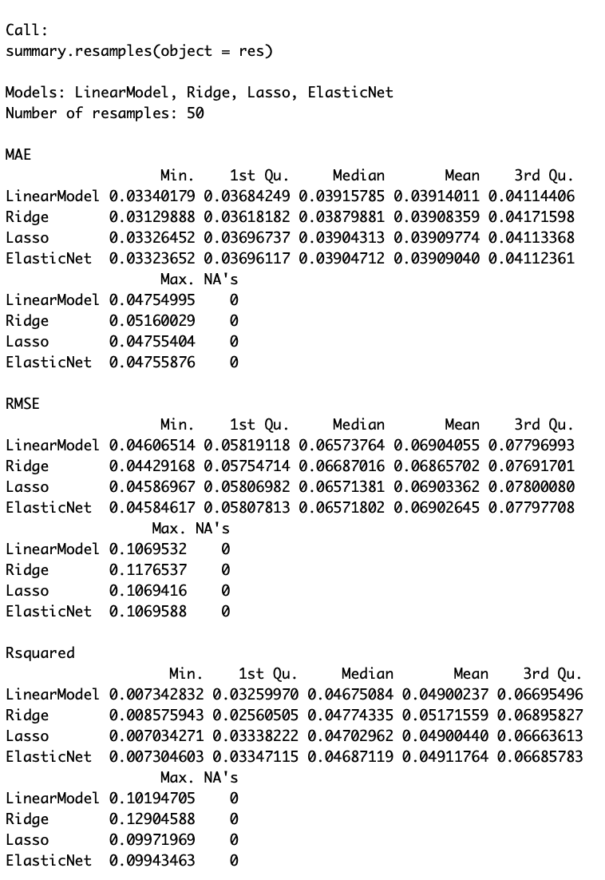
Compare modules

Slide 24
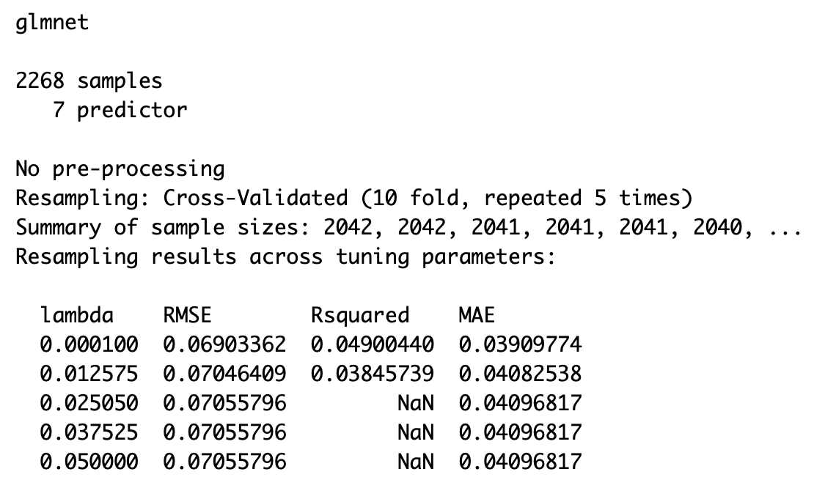

Slide 25
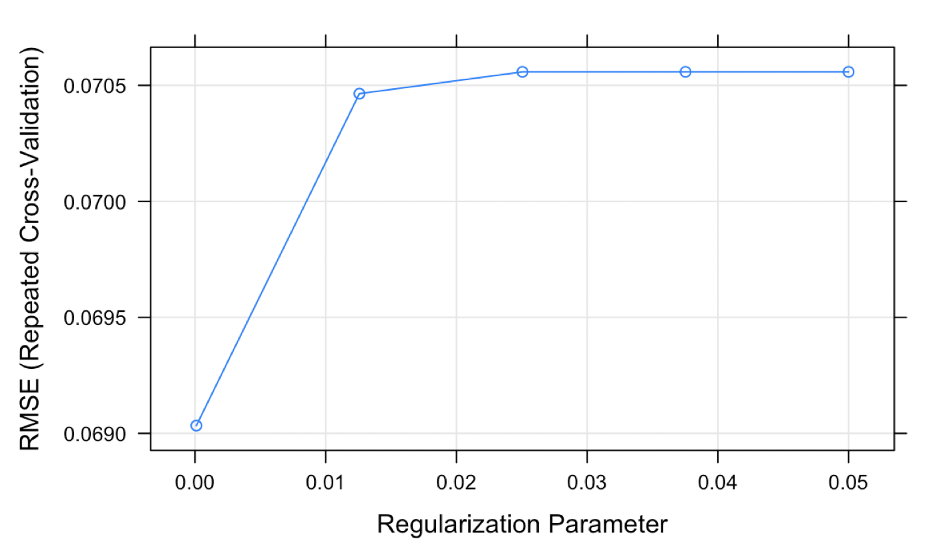
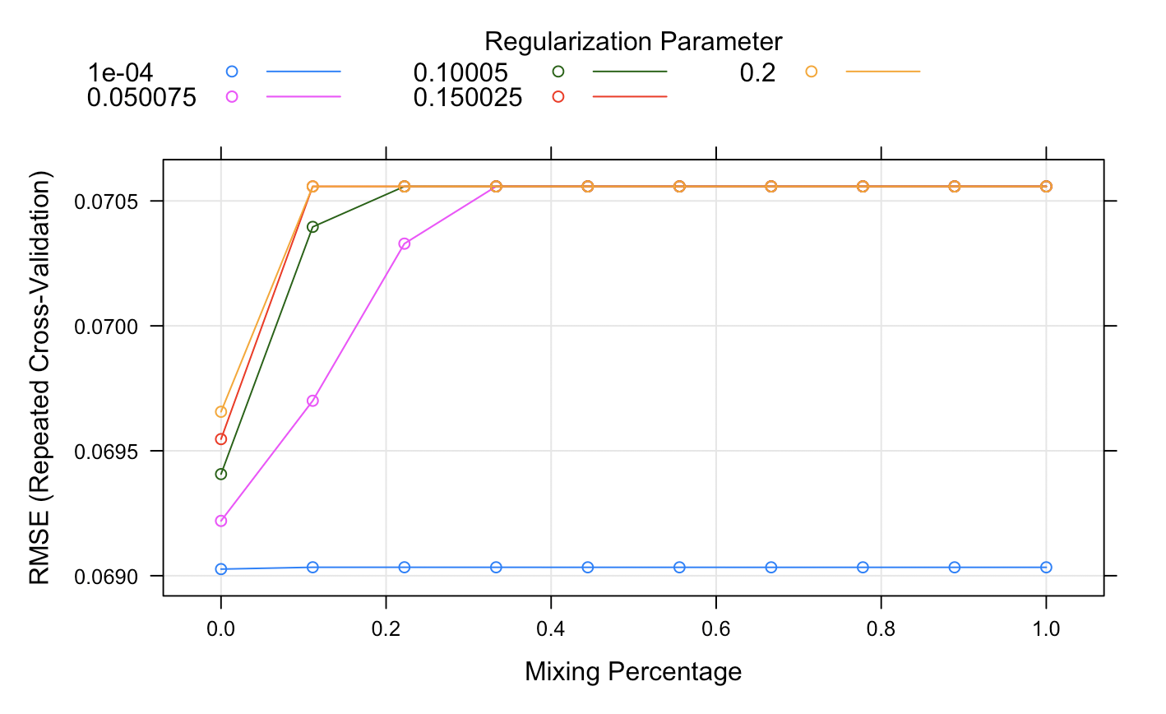
Lasso and Elastic Net
The final values used for the model were alpha = 1 and lambda = 1e-04.
Fitting alpha = 0, lambda = 1e-04 on full training set.
Elastic Net
Lasso

Slide 26
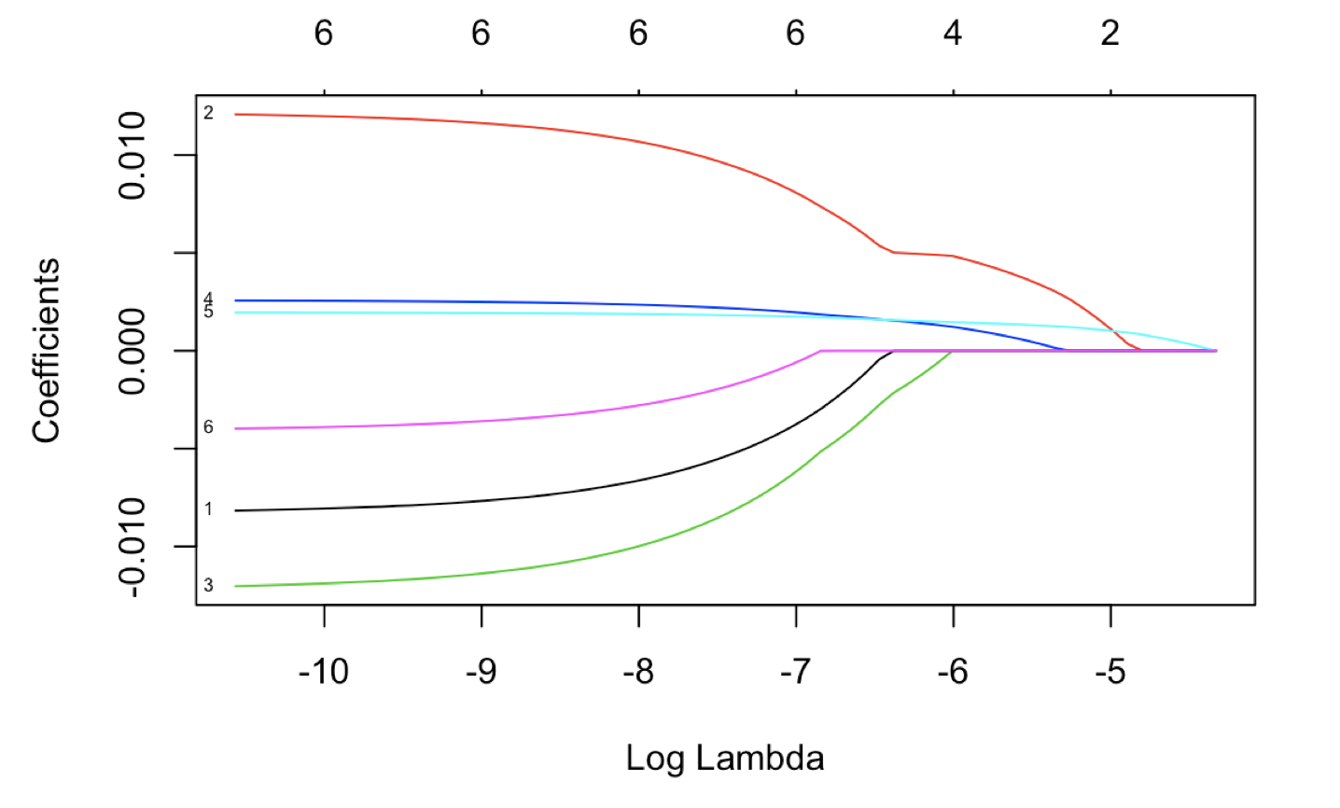
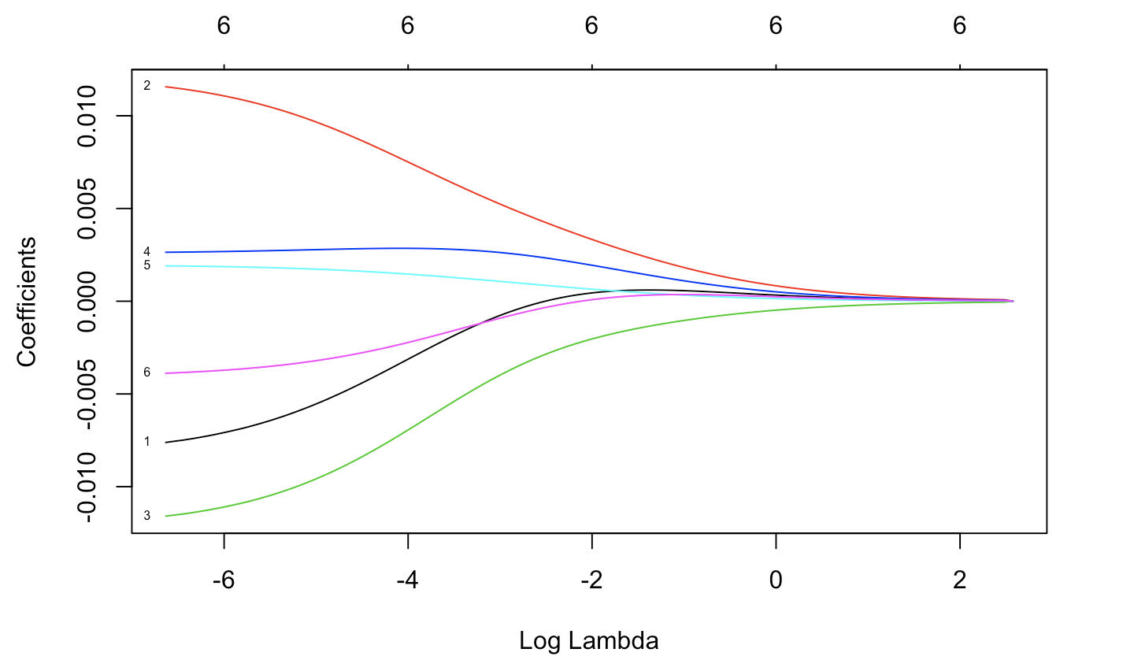
Coefficients vs. Log Lambda
Lasso
Elastic Net

Slide 27
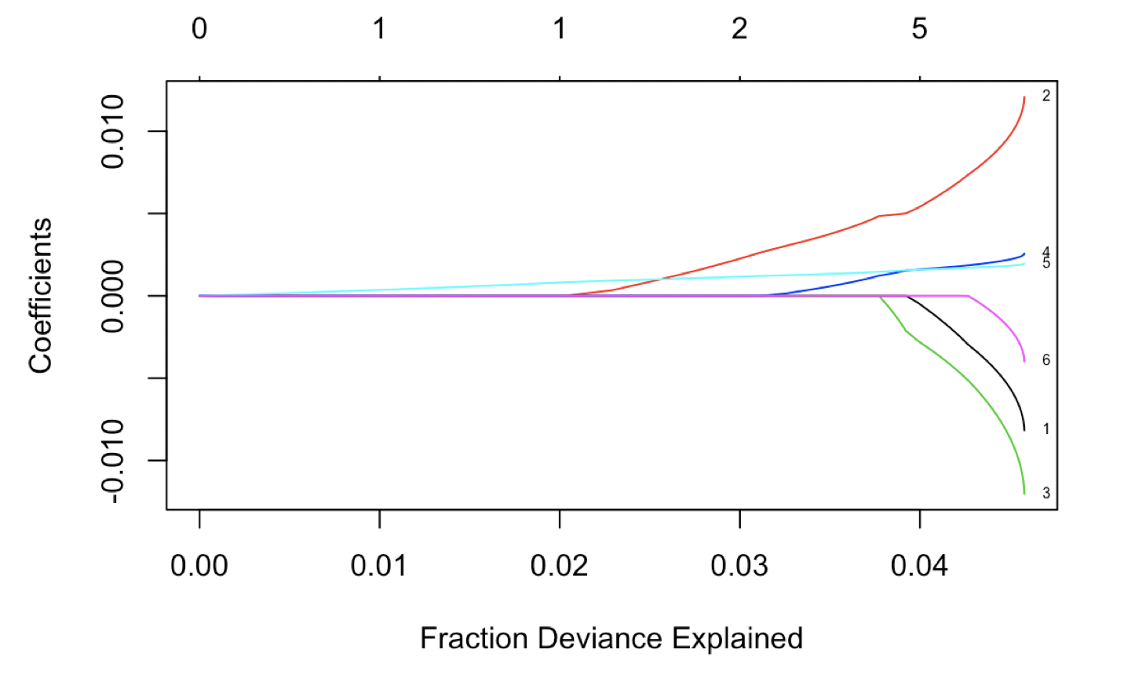
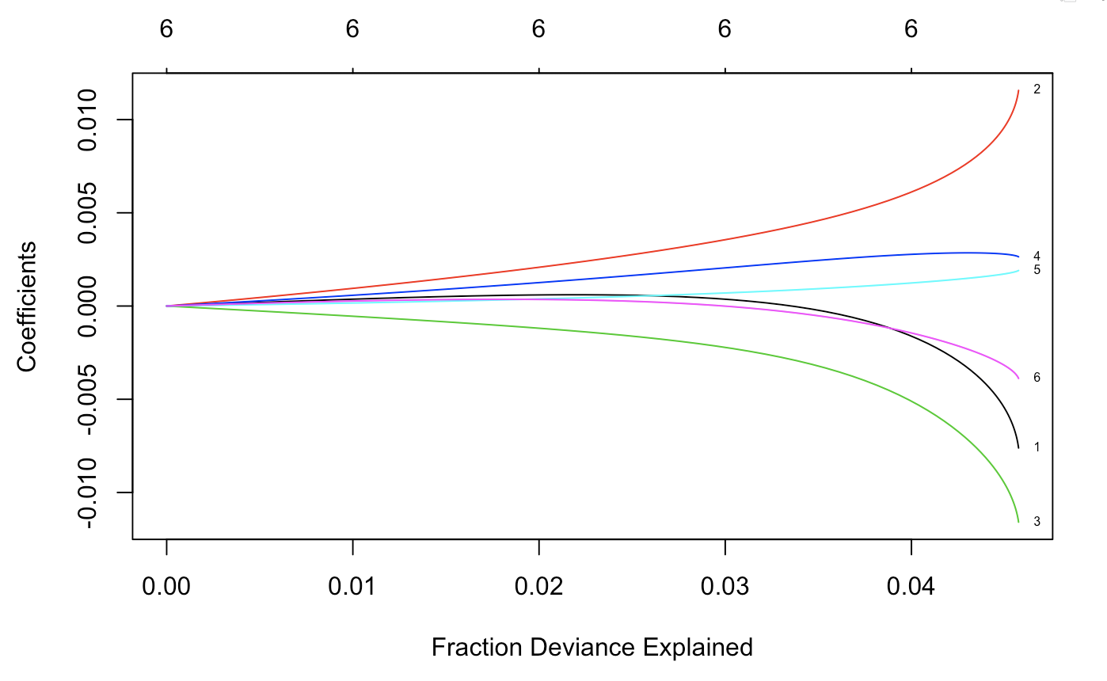
Coefficients vs. Fraction Deviance Explained
Lasso
Elastic Net

Slide 28
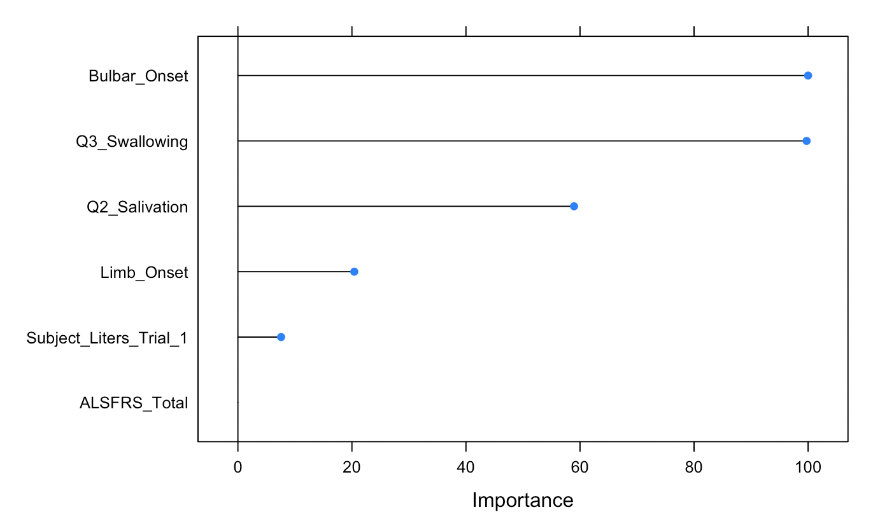
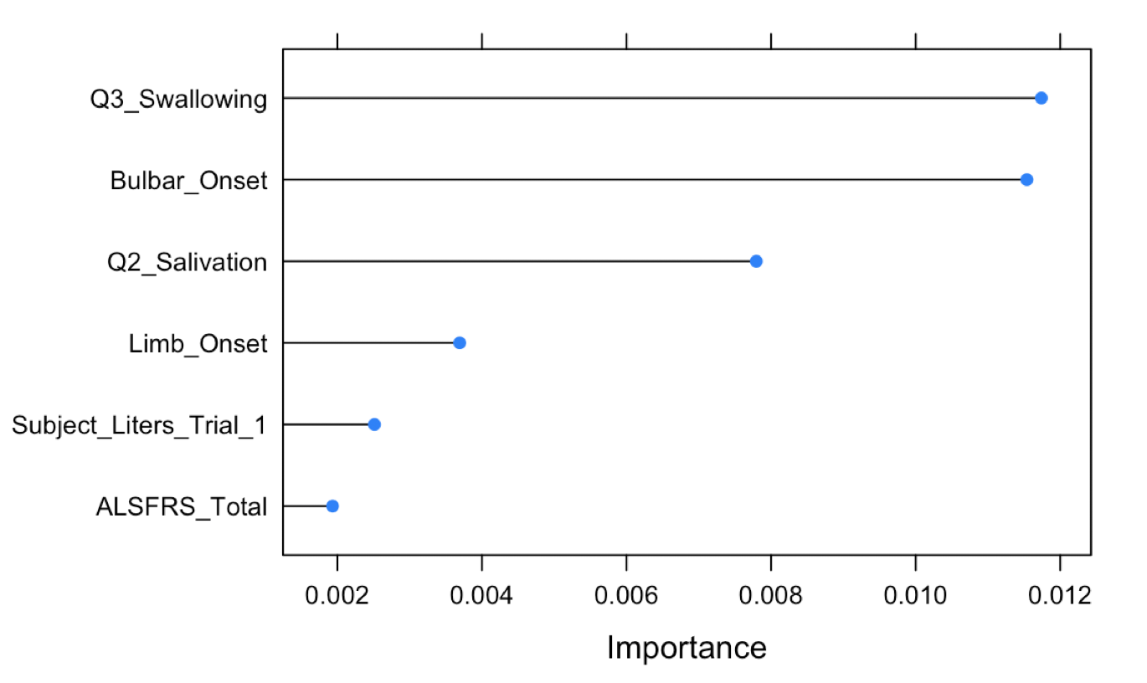
Important variables
Lasso
Elastic Net

